Slide 1




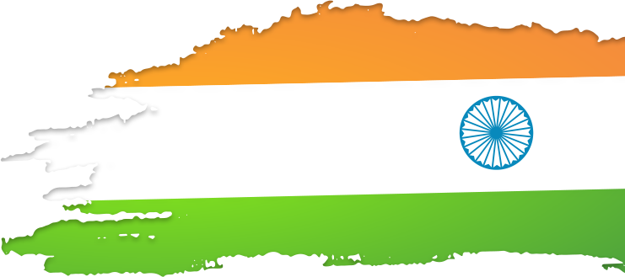
Lok Sabha Election 2024 Result Analysis
SQL Queries and Insights with Visualizations

Slide 2

ID
Introduction
Context: "The Lok Sabha elections are one of the most significant democratic processes in the world. In 2024, a total of 543 parliamentary constituencies were contested, determining the leadership of the country."
Goal of the Analysis: "This analysis aims to provide key insights into the election results using SQL queries and data visualizations."

Slide 3


ID
Agenda
Total Seats Analysis
State-wise Seats Distribution
Alliance Performance (NDA vs I.N.D.I.A.)
EVM vs Postal Votes
Top Candidates
Voter Turnout Insights
Party-wise Seats Distribution
Key Findings & Summary

Slide 4
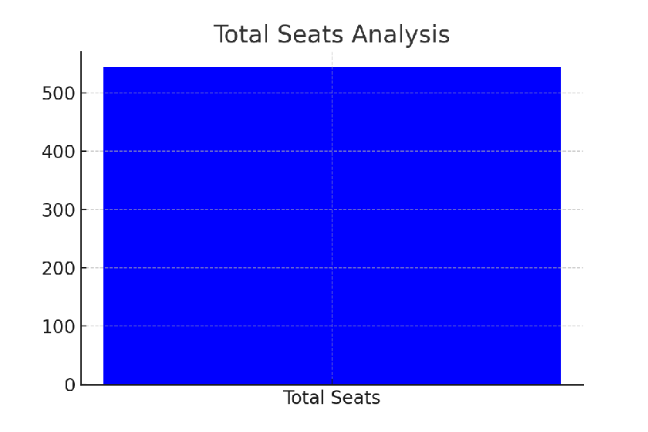
ID
Total Seats Analysis
SQL Query:
SELECT COUNT(DISTINCT parliament_constituency) AS Total_Seats
FROM constituencywise_results;
"A total of 543 seats were available for election."

Slide 5
State-wise Seats Distribution
ID
SQL Query:
SELECT
s.state AS State_name,
COUNT(cr.parliament_constituency) AS Total_seats
FROM
constituencywise_results cr
INNER JOIN statewise_results sr ON cr.Parliament_constituency = sr.Parliament_constituency
INNER JOIN states s ON sr.state_id = s.state_id
GROUP BY
s.state;

Slide 6
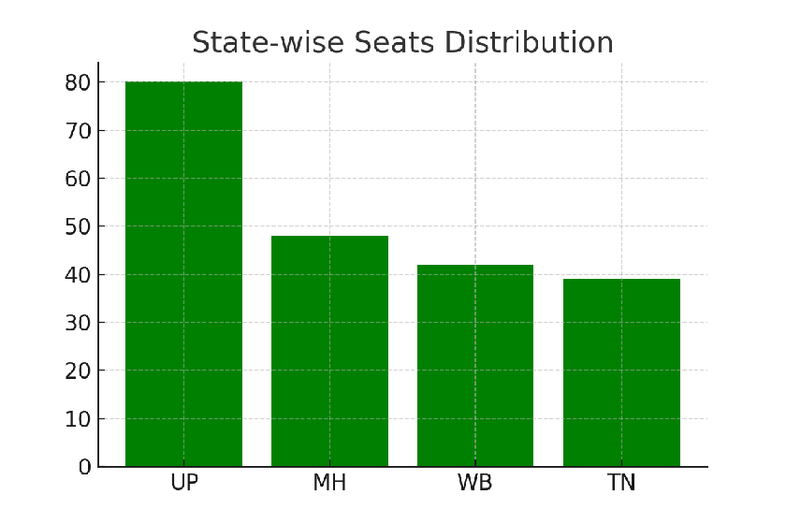
"States like Uttar Pradesh and Maharashtra have the highest number of seats."

Slide 7
ID
Total Seats Won by NDA
SQL Query:
'Sikkim Krantikari Morcha - SKM'
)
THEN [Won]
ELSE 0
END) AS NDA_Total_Seats_Won
FROM
partywise_results
SELECT
SUM(CASE
WHEN party IN(
'Bharatiya Janata Party - BJP',
'Telugu Desam - TDP',
'Janata Dal (United) - JD(U)',
'Shiv Sena - SHS',
'AJSU Party - AJSUP',
'Apna Dal (Soneylal) - ADAL',
'Asom Gana Parishad - AGP',
'Hindustani Awam Morcha (Secular) - HAMS',
'Janasena Party - JnP',
'Janata Dal (Secular) - JD(S)',
'Lok Janshakti Party(Ram Vilas) - LJPRV',
'Nationalist Congress Party - NCP',
'Rashtriya Lok Dal - RLD',

Slide 8
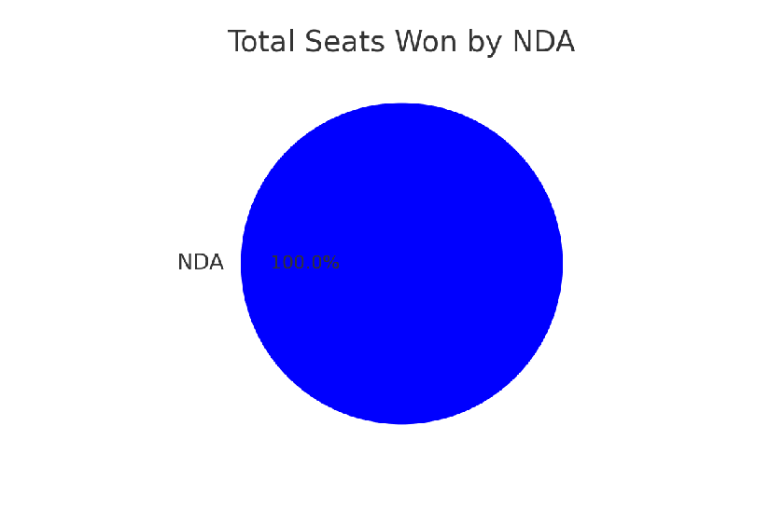
"NDA won the highest number of seats in the 2024 elections."

Slide 9
EVM vs Postal Votes in Amethi
ID
SQL Query:
SELECT
cd. EVM_Votes,
cd. Postal_Votes,
cd. Total_Votes,
cd. Candidate,
cr. Constituency_Name
FROM constituencywise_results cr JOIN constituencywise_details cd
ON cr.constituency_ID = cd.constituency_ID
WHERE cr.constituency_Name = 'AMETHI'

Slide 10
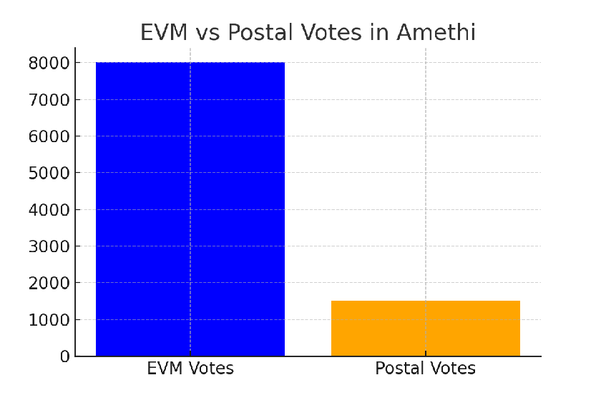
"EVM votes dominate the voting process in Amethi."

Slide 11
State-wise Alliance Performance
ID
SQL Query:
SELECT
s.State AS State_Name,
SUM(CASE WHEN p.party_alliance='NDA' THEN 1 ELSE 0 END)AS NDA_Seats_Won,
SUM(CASE WHEN p.party_alliance='I.N.D.I.A' THEN 1 ELSE 0 END)AS INDIA_Seats_Won,
SUM(CASE WHEN p.party_alliance='OTHER' THEN 1 ELSE 0 END)AS OTHER_Seats_Won
FROM
constituencywise_results cr
JOIN
partywise_results p ON cr.Party_ID = p.Party_ID
JOIN
statewise_results sr ON cr.Parliament_Constituency = sr.Parliament_Constituency
JOIN
states s ON sr.State_ID = s.State_ID
WHERE
p.party_alliance IN ('NDA','I.N.D.I.A','OTHER')-- Filter for NDA and INDIA alliances
GROUP BY
s.State
ORDER BY
s.State;

Slide 12
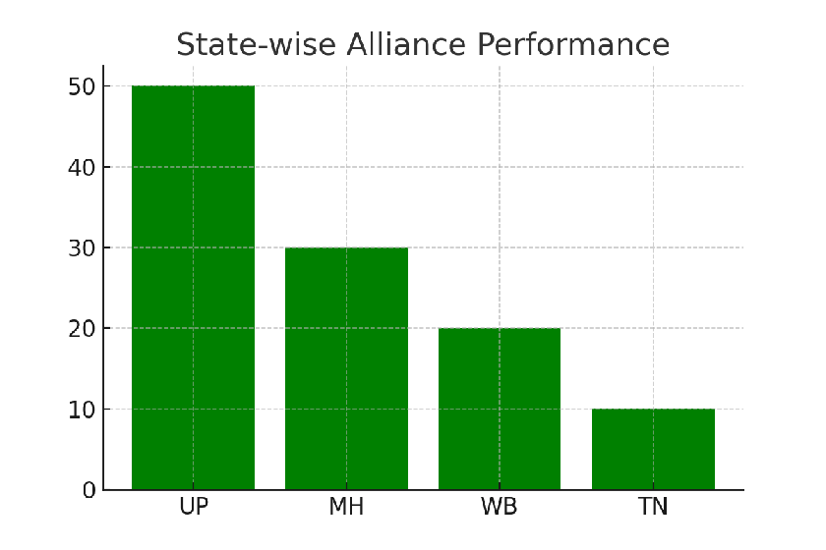
"NDA had significant state-wise variations in performance."

Slide 13
Top 10 Candidates by EVM Votes
ID
SQL Query:
WHERE
cd.EVM_Votes=(
SELECT MAX(cd1.EVM_Votes)
FROM constituencywise_details cd1
WHERE cd1.Constituency_ID = cd.Constituency_ID
)
ORDER BY
cd.EVM_Votes DESC;
SELECT TOP 10
cr.Constituency_Name,
cd.Constituency_ID,
cd.Candidate,
cd.EVM_Votes
FROM
constituencywise_details cd
JOIN
constituencywise_results cr ON cd.Constituency_ID = cr.Constituency_ID

Slide 14
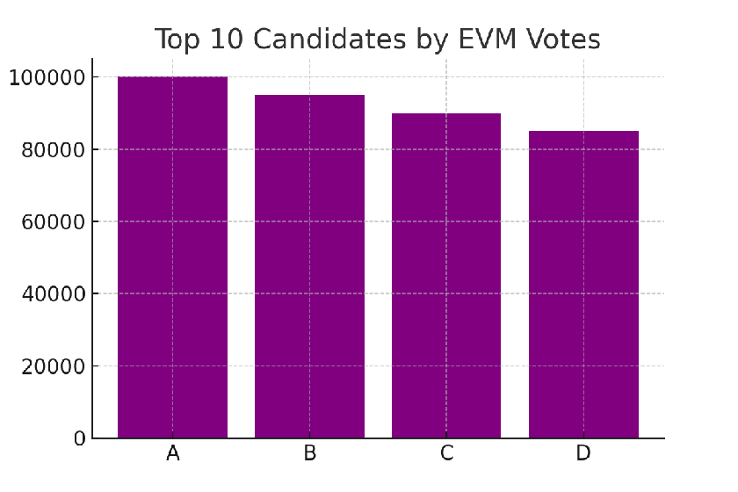
"Top candidates with the highest EVM votes secured strong mandates."

Slide 15
Voter Turnout vs Literacy Ratio
ID
SQL Query:
SELECT state, literacy_rate, voter_turnout_ratio
FROM statewise_data;

Slide 16
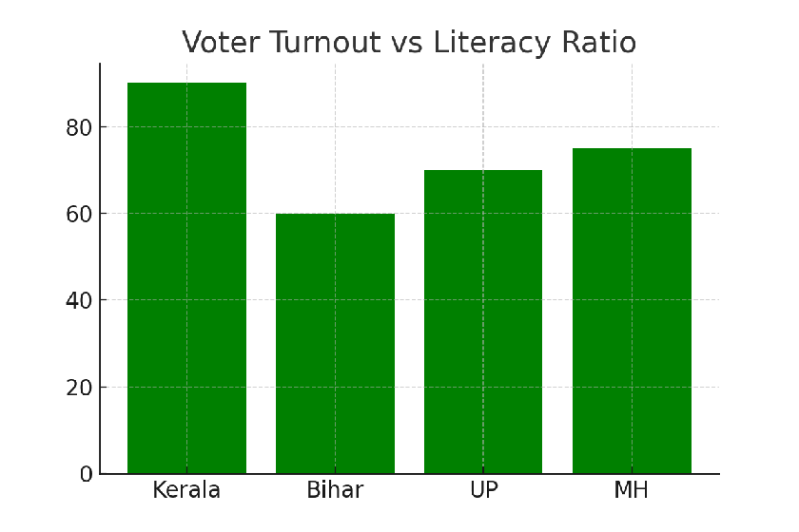
"States with higher literacy rates tend to have better voter turnout."

Slide 17
ID
Party-wise Seat Distribution
SQL Query:
SELECT Party, COUNT(Constituency_ID) AS Seats_Won
FROM constituencywise_results
GROUP BY Party;

Slide 18
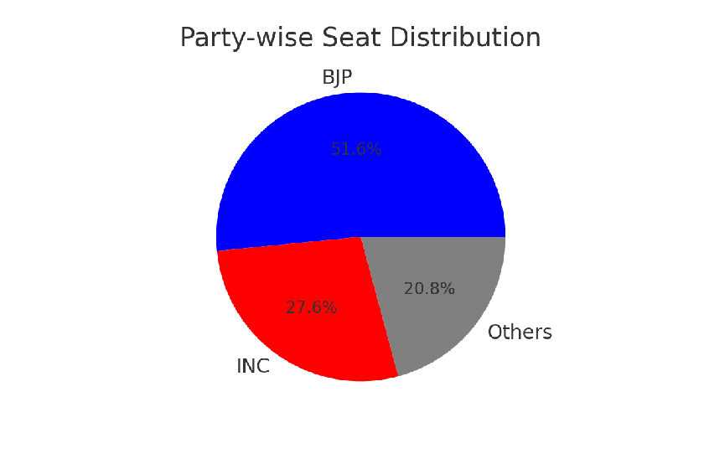
“Major national parties secured most seats.”

Slide 19
ID
Key Insights Summary
A total of 543 seats were contested in the 2024 Lok Sabha Elections.
Uttar Pradesh and Maharashtra have the highest seat distributions.
NDA emerged as the top alliance, followed by I.N.D.I.A.
EVM votes dominated the voting process across constituencies.
States with higher literacy rates showed better voter turnout.
Major national parties secured most seats.”

Slide 20
ID
Credits and References
Data Sources:
Election Commission of India
Mock data for illustrative purposes
Tools Used:
SQL for querying data
Python (Matplotlib) for generating visualizations
Powerpoint for presentation design

Slide 21
THANK YOU

